Slide 1
Sathyam shivam sundaram
-N.Kasturi

Slide 2
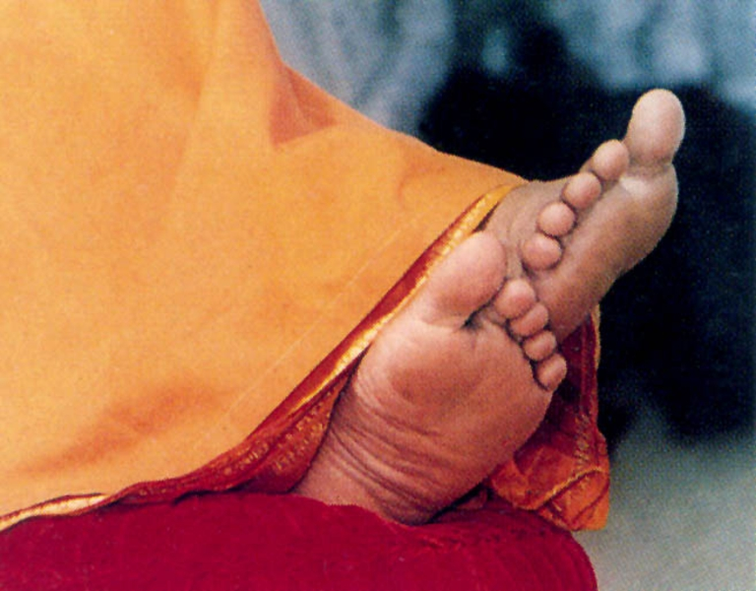
Offering our collective pranams at thy lotus feet……

Slide 3
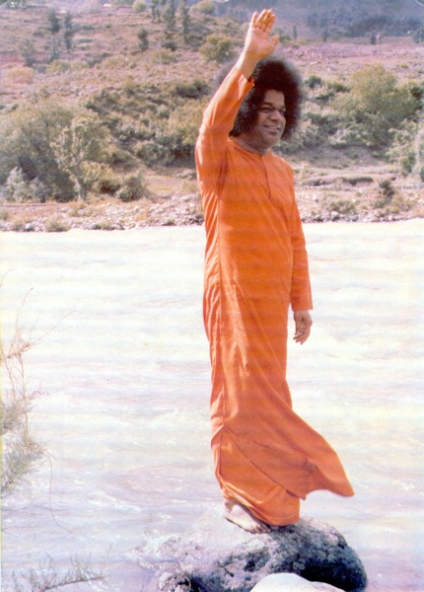
THE WAVE OF THE HAND
Chapter - 09

Slide 4
His hands confer the boons the devotees deserve. That hand has the healing touch; it can wipe out diseases, ward off evil.

Slide 5
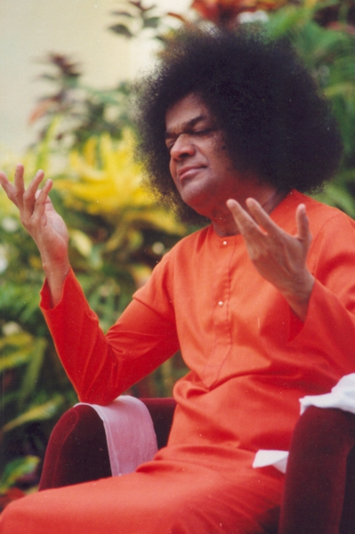
Even as a child, Baba had miraculous power of materializing things from nowhere .He used to surprise his friends by taking pepperments from empty bags. When his friends forced him to say about this top secret, Swami said that it was because of GRAMA SHAKTI. He also got green leaves from Himalayas for the cure. After baba declared his avatar, He regularly materialized “VIBHUTI” or “SACRED ASH”. People called the
“SACRED ASH” as kailasa vibhuti since it is associated with the lord shiva.
The “SACRED ASH” was also called
BHAMSA :Because it burns all the sins
BHASITAM:Because it increases one’s spiritual splendour
RAKSHA :Because it is an armour against the machinations of evil spirits.

Slide 6
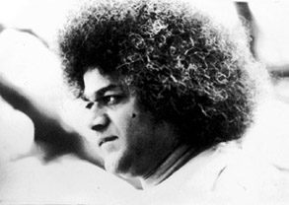
The creation of this vibhuti was indeed inexplicable,ultra-scientific wonder.It was done so casually,so gracefully, and effortlessly.It was so natural that we might even miss the significance of the divine blessing
The right palm is held directly down or at an angle, a wave or two that is scarcely noticeable,the fingers closed to arrest the fall of vibhuti and the vibhuti is hands on to you and kept on forehead.
The vibhuti that Baba gives to everyone as token of His blessings is preserved carefully and worn on the forehead.It is placed on tongue or mixed with water and drunk to cure diseases.It is carried as a talisman.

Slide 7
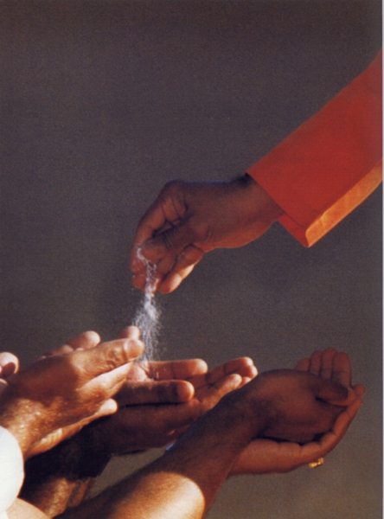
The vibhuti that HE gives is of hundred different kinds.It is sometimes in the shape of a
Hard cube
Powder,fine, grainy and flasky
Fragnant or pungent-smelling
Saltish in taste or sweet or even tasteless
White or blackish
Sometimes,when waved….it emerges as a container.

Slide 8
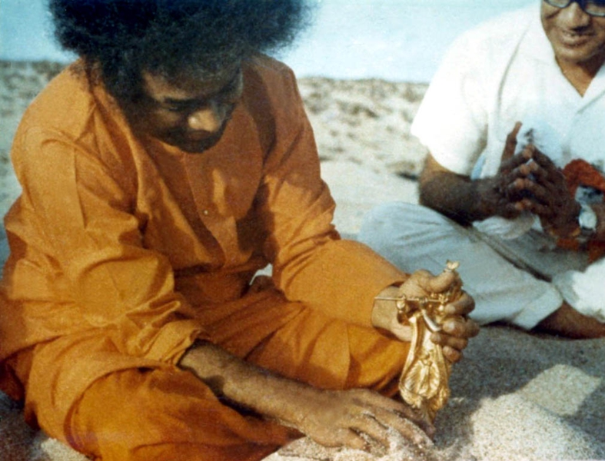
Swami has this superior things to convert impossible to possible things.
HE just taps on the empty vessel,and the next second, the container is filled with vibhuti.
Another instance is when HE gathers his devotees on the banks of the river Chitravathi,HE takes the sand and pours in on a plate which eventually turns into vibhuti.
Sometimes devotes saw vibhuti emanating from HIS face,thumb,mouth,eyes,toe and forehead…

Slide 9

Swami signifies his presence at the residenceof his devotees. Devotees dreamt that Baba came to them and applied vibhuti on their browsand eventually when the devotes woke up next morning,the vibhuti was actually there!!!!!!! Not just on the forehead,but they found vibhuti on their tongue tooo!!

Slide 10
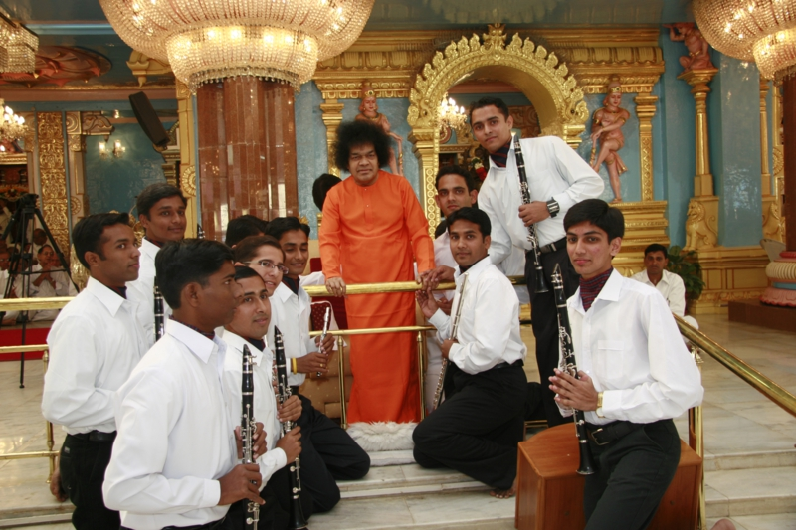
Baba blessed artists , who preformed in prasanthi nilayam during festivals and events with gifts , rings , chains. there will be a special approiateness in gifts too.

Slide 11
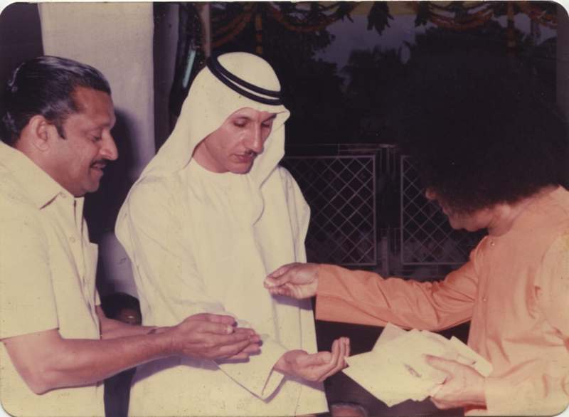
Nadaswara vidwan was given a ring of shiva and an enquire says that his family from generations served as muscians for tiruvegadu temple.
Swami then gave a ganesh to a devotee.
Swami gave linga to devotee for whome he already gave a krishna idel and which was lost and a priest told that he is having a dosha and told him to do rudrabhishekam and he came to prasanthi and swami told without anger that krishna is with me take the linga.
It is not right to weigh the value of gods gift because they are not of this world .

Slide 12
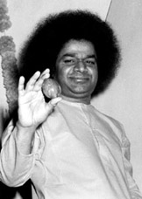

The things that baba gave can never be lost. Once a devotee bag was stolen and she complained to police and after two day the bag was recovered and every thing was there except the japamala that swami gave and she wrote a letter to swami and swami replied back that it is with him.
A devotee , CNP writes , it was 20 years ago when swami talked with him about his own problems and gave a raksha and he thought that even he is having a raksha why swami gave another , that he is in much danger and asked swami and swami said it was stolen .

Slide 13
Once Srimati Sakamma garu lost her ring which was given by swami , she asked swami and swami made fun of her and after somedays swami asked , “O , Sakamma , you want that ring , is'nt it ? and it was there in his hand.
When swami is on his way to banglore the car stopped and he asked a devotee to bring water and kept his fingers in it and it became petrol and car didnt stop for many miles.

Slide 14
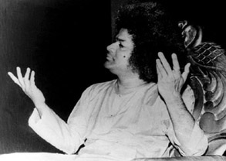
when sakamma broke her glasses in parthi and was facing difficulty swami gave her glasses of same focal length she required.
When swami went to madras on the occasion of krishna birthday, he created 43 varieties of sweets after harati in a different pose which no one saw by raising his hands above his head.

Slide 15
When baba took 2 jeeps of devotees to a mid forest area 6 moles far from chitravati river and created candys and 16 photos of himself , even there occasions when he taken bigger packets where were bigger parties but always the number will tally.
In 1958, when Swami went to kanayakumari with some devotees he told them the story of the nose stud of godess which was stolen by the parites and swami asked devotees "do you want to see it" and with in no time he patted the sand and it was a huge diamond and it was shown to every one.

Slide 16
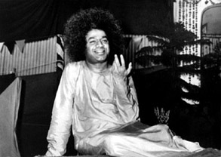
When a devotee used his friends autograph note and was feeling bad and swami got to know and he gave the same note to the young man.
Swami materialised many things like rudraksha, japamala, tulsi beads, gita, lingams, image of krishna, mahishasuramardini, dattatreya and many.
Swami gave lovely silver icon of kusuma and haranath from sand who has a bandage which represented saintly couple.
swami gave sandalwood images all kinds of lingas , different kinds of jem set rings and more.

Slide 17
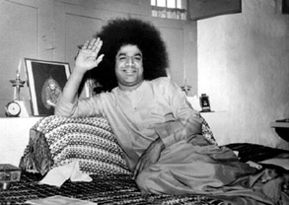
Swami used to gently paas his hand over a piece of paper and it becomes as silver sheet which consists a mantera and a image of adhistanadevata.
Swami handa have naother miraculus power that he can mautiple any content which he wants and in 1950 on vijayadasami day devotees are decorating with tulasi and the two baskets they brought are not sufficient and the swami saked that they want more and swami kept his hand in the basked and the baskets are full , this is the reason why swami himself gives sweets to devotees.

Slide 18
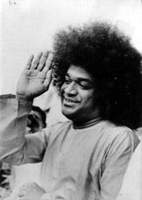

On Shivaratri and Vijayadashami day swami used to pluck petals of the fowers of his garland and throw on the heads of devotees and they become into peppermints and many.
Swami cured the disease of swami amritananda by giving vibhudi and a golden powder and some fruits and leaves juice which he didnt see anywere in indian . Swami amritanand said in his own words about what are the things that swami gave his on the 4 or 5 days and the taste of them which cured his disease.

Slide 19
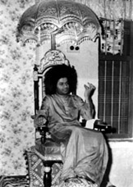
Swami whenever wants to give any medicion he used to give them as pills.and swami used to gove fruits to progenent woman .
A devotee once asked swami to permit him to leave parthi to get a diploma from chennai and sawmi asked do you want it and waved his hands and it was in his hand.
When a devotee arranged for gowri pooja in his home and collected all requirements except a black bead which is important and swami came to his home and swa a black ant in the flowers and took it into his hand and made it 2 black beads and ket in his wife hand.

Slide 20
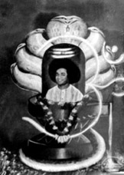
At Thippegondanahalli near banglor swami materalised a kooja of nector for 10 devotees and the next devotee didnt git the chance to take nector and swami saw it and gave him and his wife a full kooja of nector.
In a reservoir which supplies water to banglor a devotee is saying that the dam water closed the sangameshwara temple and then swami kept his hand in the water and took spakata limnga and gave it to a veera saiva member in the devotees.
When swami blesses his devotees to arrange their marrage of their children swami used to materalise mangala sutram and give then and whileear piercing ceremony he used to materalise a sharp pointed contraption and which is then made into ear ring.

Slide 21
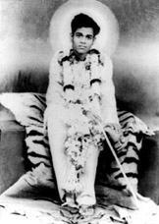
16 years ago baba at his teen when he went to a garden near sheb tank they had food and returning back to the village while darkness was fast and from bushes a snake came and coiled swamis leg and when swami camanded to go it left his leg and was seen no more and it bit swami, one boy whith swami started running to village when swami was about to faint and fall and swami asked the devottes who were trying to do firstaid to stop and he waved his hand a talisam came, he asked to apply it and swami come back to normal form.

Slide 22
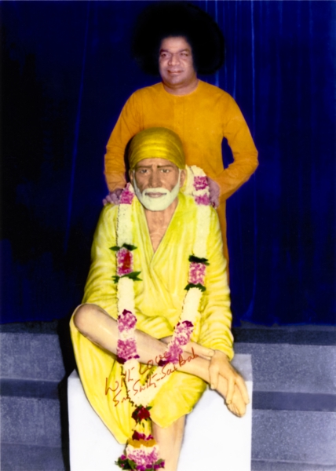
Then people came running and swami greeted then and swami told then that i never use talisam for my own sake.
Hemadpant said shridi baba used to give udhi as prasda and used to keeep his hand on devotees and sent then as the same way sathya sai baba also gives vibhudi as prasadam and keep his hand on the heads of devotees to take their boons
30.

Slide 23
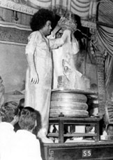
That hand has the healing touch , it can wipe a disease , ward off evil , exorcise the devil and rewrite destiny.......

Slide 24
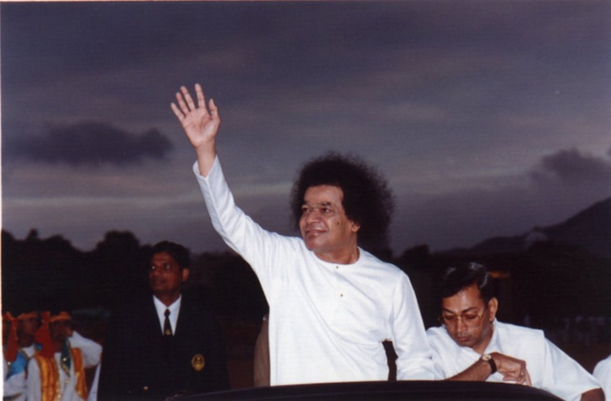
Thank you… sai ram -SWAROOP -SATHVIK -DURGA -PUNEETH -SREEKHAR

